Slide 1
MongoDB Datatypes

Slide 2
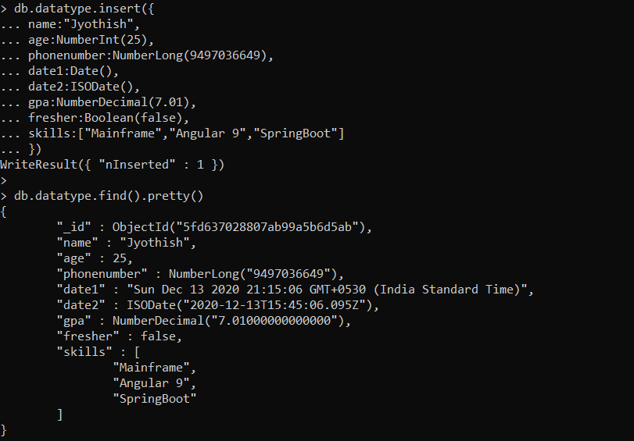
Basic Types

Slide 3
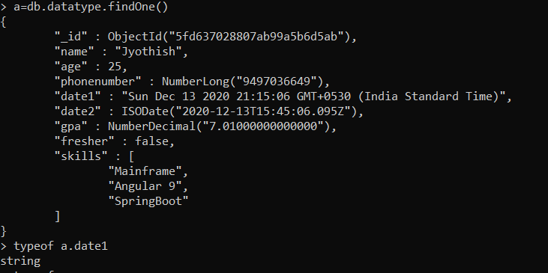
typeof(Check Type)

Slide 4
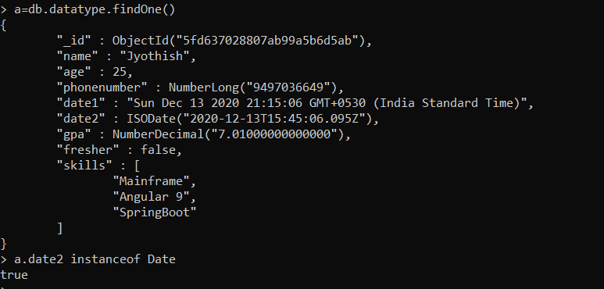
Instanceof(Check Type)

